Slide 1
Destiny 2
Exotic Armor
BY: SEAN LI AND PETER MENDOZA

Slide 2
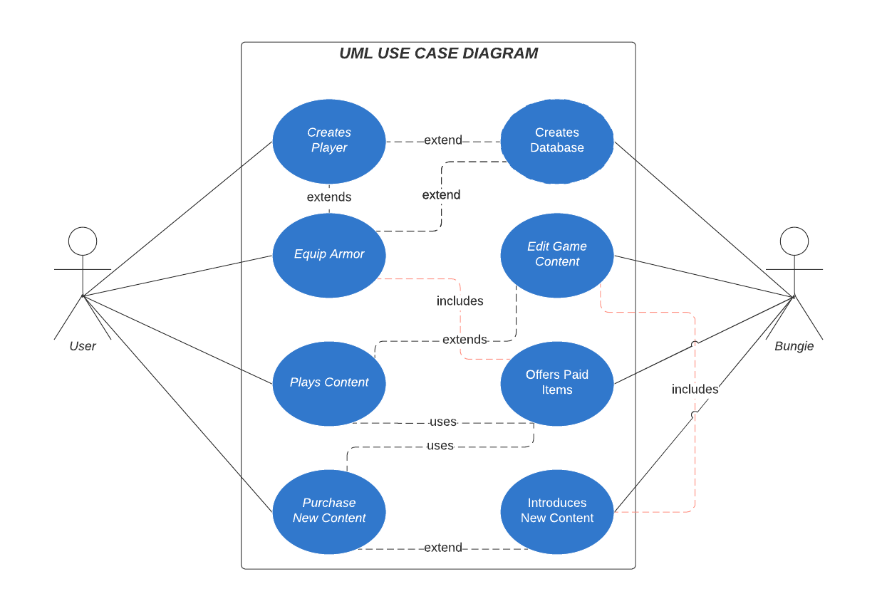
UML Diagram
Lucid Chart

Slide 3
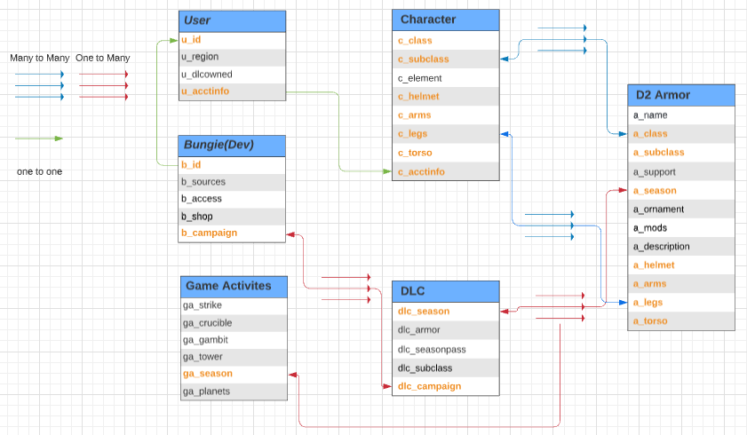
E/R Diagram

Slide 4
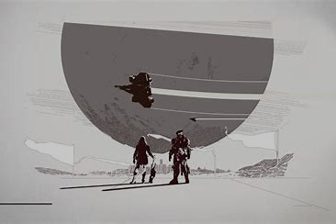
Relational Schema
User
u_id, u_region, u_dlcowned, u_acctinfo
Bungie(developer)
b_id, b_sources, b_access, b_shop, b_campaign
Character
c_class, c_subclass, c_element, c_helmet, c_arms, c_legs, c_torso, c_acctinfo
DLC
dlc_season, dlc_armor, dlc_seasonpass, dlc_subclass, dlc_campaign
D2 Armor
a_name, a_class, a_subclass, a_support, a_season, a_ornament, a_mods, a_description, a_helmet, a_arms, a_legs, a_torso
Game Activities
ga_strike, ga_crucible, ga_gambit, ga_tower, ga_season, ga_planets

Slide 5

That’s all Guardian
Notes:
https://github.com/Sean02/Destiny_2_Exotic_Armor

